Slide 1
Continuous joint distributions

Slide 2

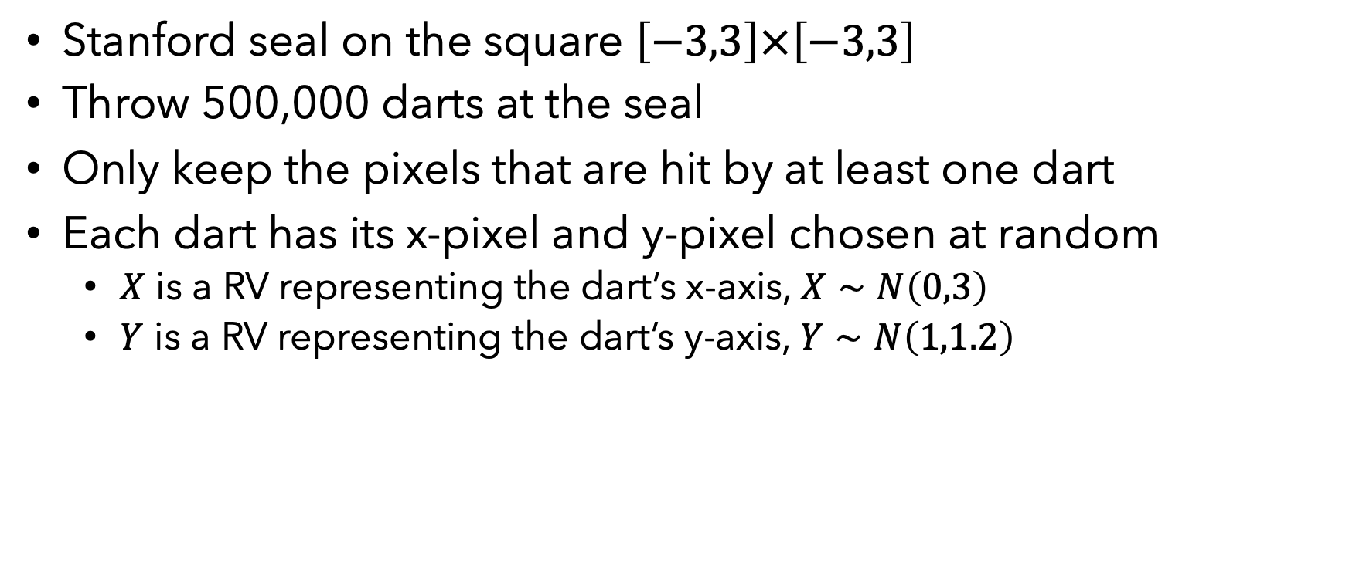
Throwing darts at the Stanford seal
Stanford seal on the square $\left[−3,3\right]×\left[−3,3\right]$
Throw 500,000 darts at the seal
Only keep the pixels that are hit by at least one dart
Each dart has its x-pixel and y-pixel chosen at random
$X$ is a RV representing the dart’s x-axis, $X∼N\left(0,3\right)$
$Y$ is a RV representing the dart’s y-axis, $Y∼N\left(1,1.2\right)$
Example by Chris Piech from CS109

Slide 3
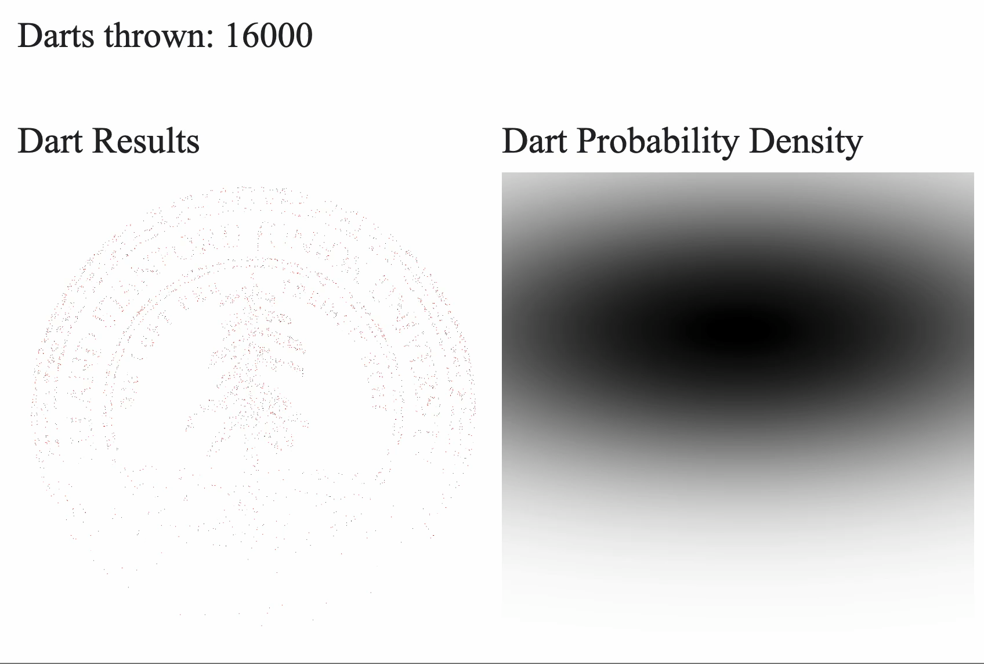
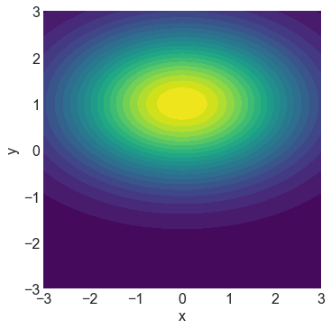
Throwing darts at the Stanford seal
Dart Probability Density

Slide 4
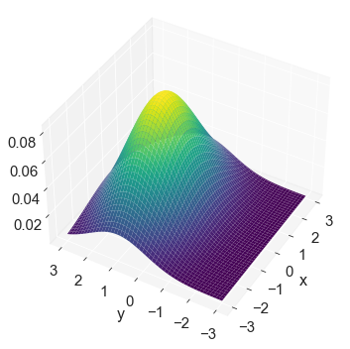
Throwing darts at the Stanford seal
Dart Probability Density (3D view)
Dart Probability Density (2D view)

Slide 5
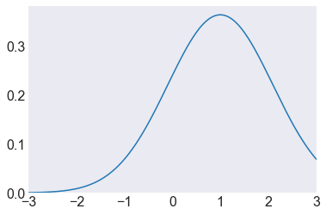
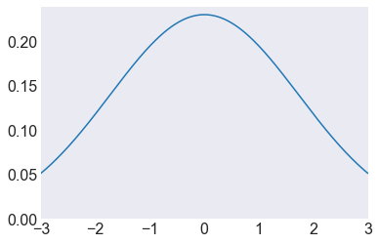
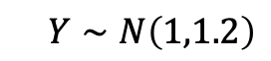
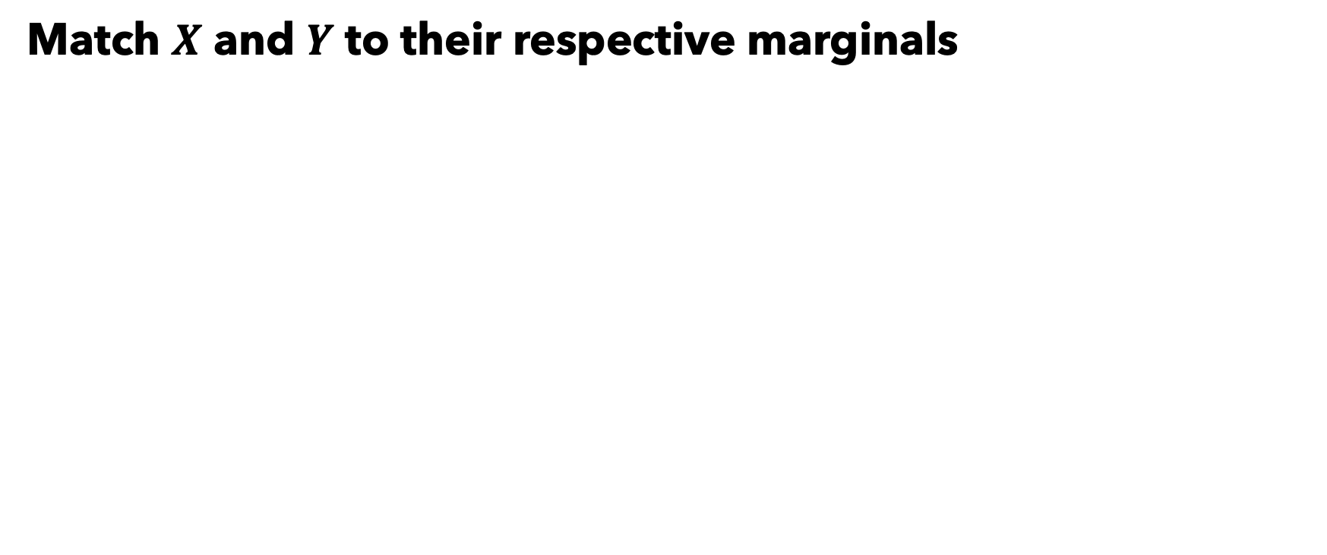
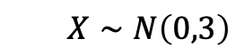
Throwing darts at the Stanford seal
Match $X$ and $Y$ to their respective marginals
Dart Probability Density (3D view)
$Y∼N\left(1,1.2\right)$
$X∼N\left(0,3\right)$

Slide 6
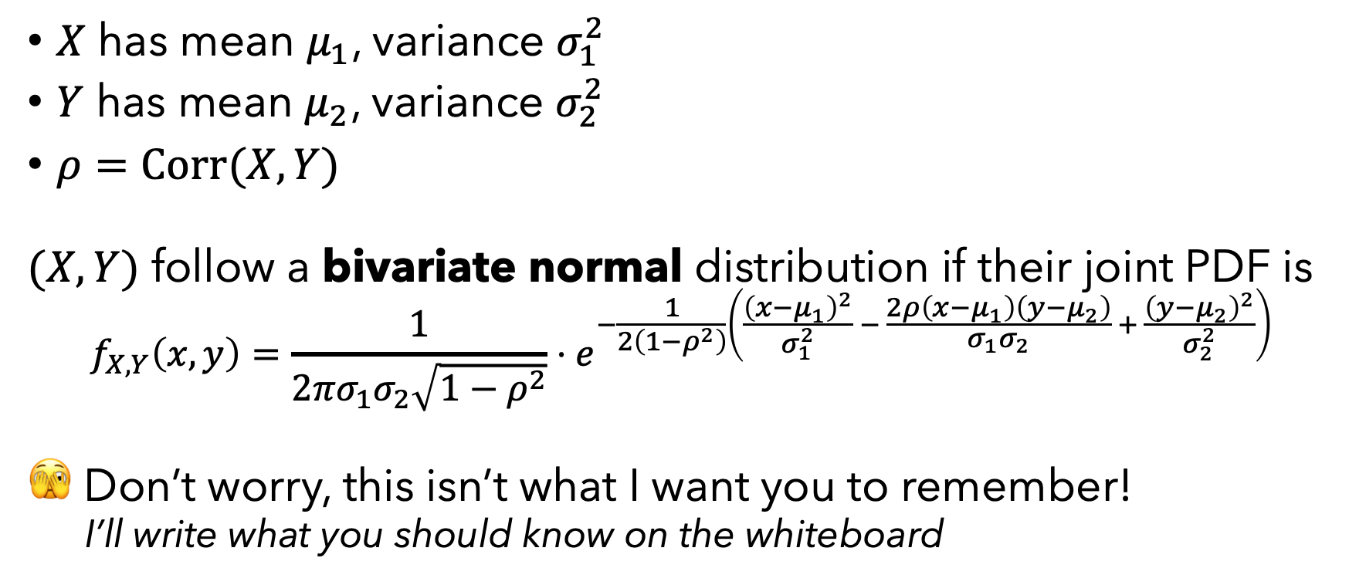
Bivariate normal distribution
$X$ has mean $μ_{1}$, variance $σ_{1}^{2}$
$Y$ has mean $μ_{2}$, variance $σ_{2}^{2}$
$ρ=Corr(X,Y)$
$(X,Y)$ follow a bivariate normal distribution if their joint PDF is
$$f_{X,Y}\left(x,y\right)=\frac{1}{2πσ_{1}σ_{2}\sqrt{1−ρ^{2}}}⋅e^{−\frac{1}{2\left(1−ρ^{2}\right)}\left(\frac{{\left(x−μ_{1}\right)}^{2}}{σ_{1}^{2}} − \frac{2ρ\left(x−μ_{1}\right)\left(y−μ_{2}\right)}{σ_{1}σ_{2}} + \frac{{\left(y−μ_{2}\right)}^{2}}{σ_{2}^{2}}\right)}$$
🫣 Don’t worry, this isn’t what I want you to remember!
I’ll write what you should know on the whiteboard

Slide 7
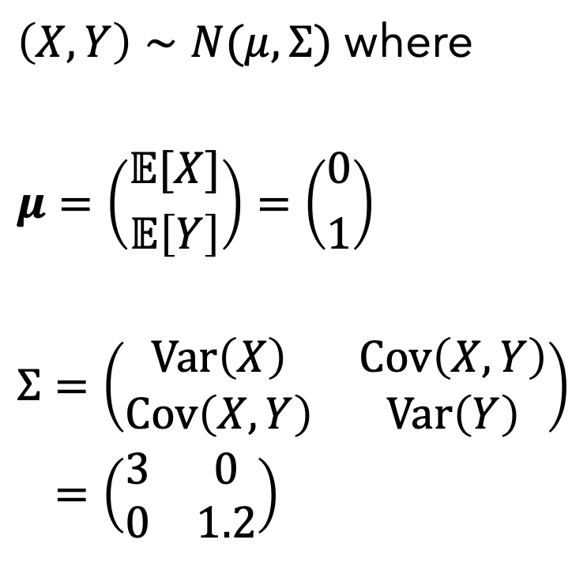
Throwing darts at the Stanford seal
Dart Probability Density (3D view)
Dart Probability Density (2D view)
$\left(X,Y\right)∼N(μ,Σ)$ where
$$μ=\left({𝔼[X] \atop 𝔼\left[Y\right]}\right)=\left({0 \atop 1}\right)$$
$$Σ=\left(\begin{matrix}Var\left(X\right) & Cov\left(X,Y\right) \\ Cov\left(X,Y\right) & Var\left(Y\right)\end{matrix}\right)$$
$$Σ=\left(\begin{matrix}3 & 0 \\ 0 & 1.2\end{matrix}\right)$$

Slide 8
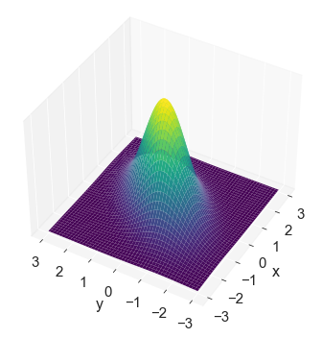
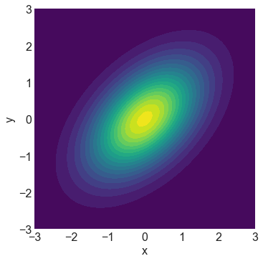
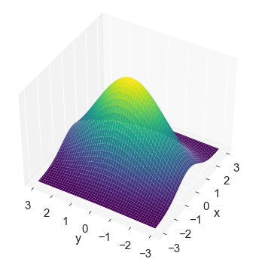
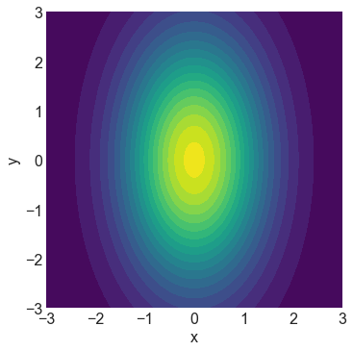
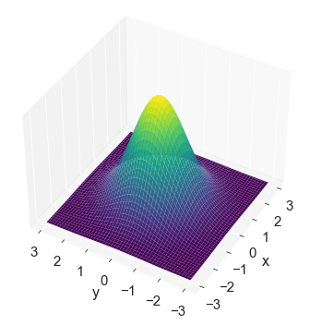
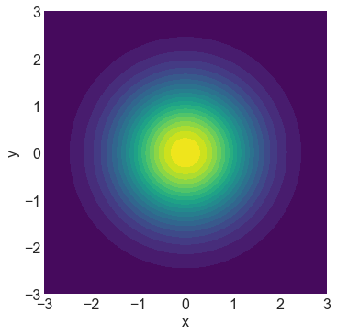
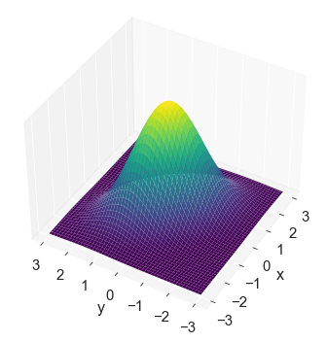
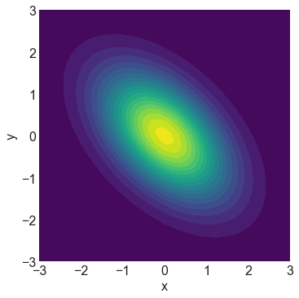
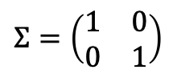

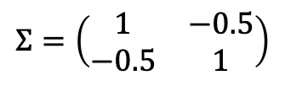
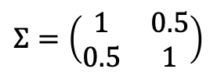
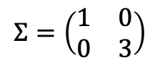
Match the plot to the covariance matrix (all with $μ=(0,0)$)
A
$$Σ=\left(\begin{matrix}1 & 0 \\ 0 & 1\end{matrix}\right)$$
B
$$Σ=\left(\begin{matrix}1 & 0 \\ 0 & 3\end{matrix}\right)$$
C
$$Σ=\left(\begin{matrix}1 & 0.5 \\ 0.5 & 1\end{matrix}\right)$$
D
$$Σ=\left(\begin{matrix}1 & −0.5 \\ −0.5 & 1\end{matrix}\right)$$
1
3
2
4

Slide 9
Match the plot to the covariance matrix (all with $μ=(0,0)$)
A
$$Σ=\left(\begin{matrix}1 & 0 \\ 0 & 1\end{matrix}\right)$$
B
$$Σ=\left(\begin{matrix}1 & 0 \\ 0 & 3\end{matrix}\right)$$
C
$$Σ=\left(\begin{matrix}1 & 0.5 \\ 0.5 & 1\end{matrix}\right)$$
D
$$Σ=\left(\begin{matrix}1 & −0.5 \\ −0.5 & 1\end{matrix}\right)$$
C
B
1
3
A
D
2
4

